Slide 1


PLANT NURSERY MANAGEMENT APP
CAN THO UNIVERSITY SOFTWARE CENTER
MEKONG DELTA - APTECH
PLANTPAPLACE
Mentor: Class: CP2296M03
Ms. Le Thi Minh Loan Team: MF Team
Students:
1. Student1374896 - GIANG THU DUYEN (Team Leader)
2. Student1374885 – TRAN HUU PHUC
3. Student1374892 – TRAN HONG TEM
4. Student1276291 – DINH HUU LOC

Slide 2
Content Overview
1. Problem and solution
2. Application functions
3. Major Project Milestones
4. Technology used
5. Application demo
6. Remaining problems

Slide 3
1. Problem and solution – 1/2
Due to the rapid increase in demand for caring for, learning about, and shopping for ornamental plants, there is still no application or platform that provides enough information.
The challenge of combining crop knowledge and online shopping.

Slide 4

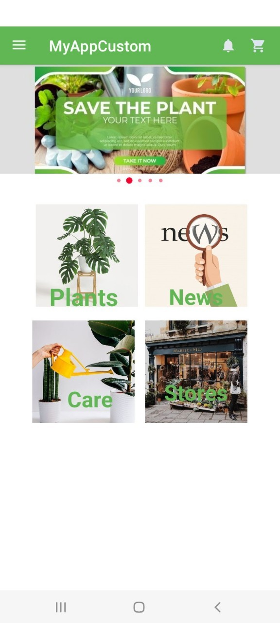
1. Problem and solution – 2/2
PlantPaplace app emerged as a great solution.
Figure 3. PlantPaplace App

Slide 5
2. Application functions
1. Register/Log in to your account
2. Account management
3. View the plant list
4. View details of the crop
5. Search for keywords and sort by option (developing)
6. Add product into cart and place order (developing)
7. Manage orders and view purchase history (developing)
8. Suggestions on the application (developing)
9. Contact the store owner when you need support or discussion.

Slide 6
3. Major Project Milestones
9/8: Analyze topics, design layouts and databases (basic)
Time: 11:30AM – 17:45PM (center)
Another time: work at home
10/8: Complete the interface and database
Time: 7:30AM – 16:45PM (center)
Another time: work at home
11/8: Function code for each activity
Time: 7:30AM – 15:00PM (center)
Another time: work at home
12/8: Function code for each activity
Time: 8:00AM – 16:30PM (center)
Another time: 18:30PM– 3:45AM (center)
13/8: Function code for each activity
Time: 8:30AM – 16:30PM (center)
Another time: 19:30PM - 3:45AM (Coffe Store)
14/8: Packing and handing over the project
Time: 7:30AM – 11:55AM (center)

Slide 7


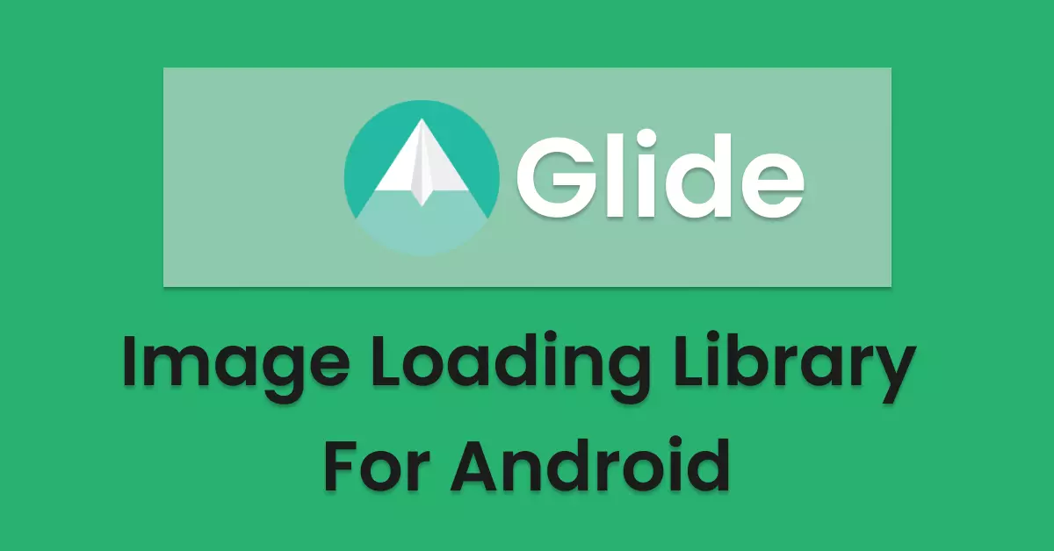
4. Technology used – 1/4
About language: Java
About database: Firebase
About images: Glide to display images from the internet or local

Slide 8
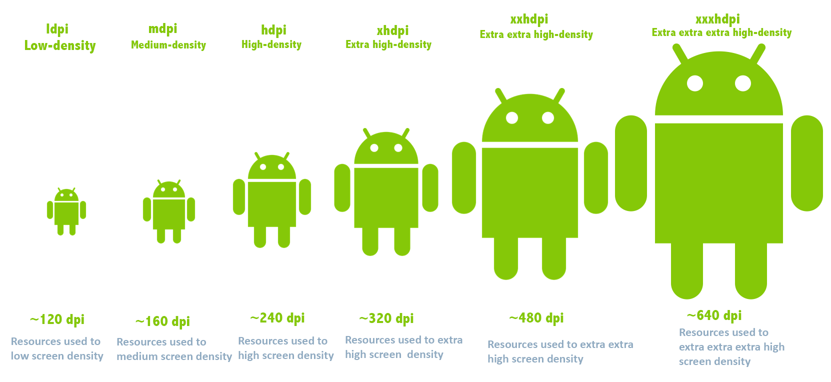
4. Technology used – 2/4
UI/UX Design:
Support equipment: devices using the Android operating system (phone, tablet,...)
Resolution: minimum 800 x 480
Density: HDPI, MDPI, XHDPI,…

Slide 9
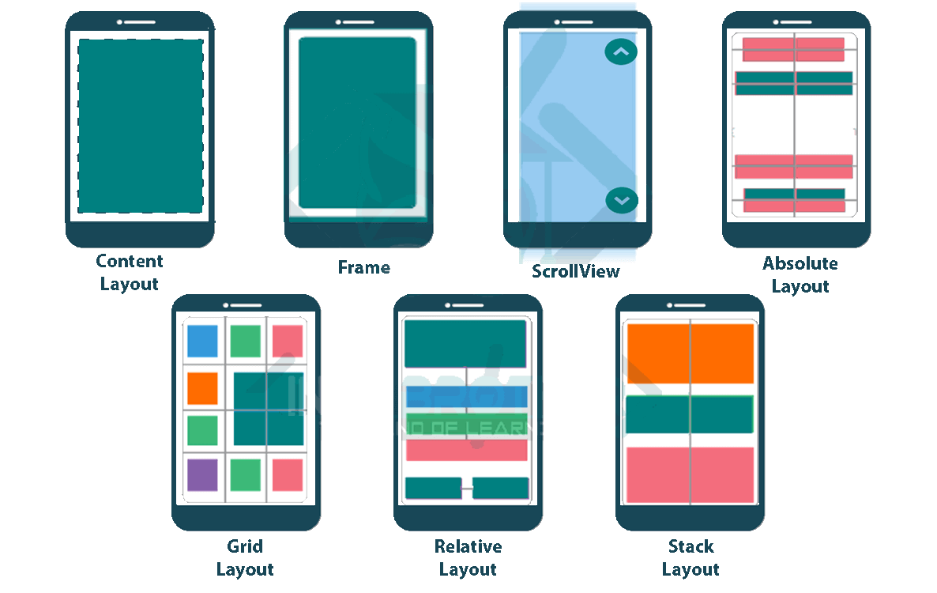
4. Technology used – 3/4
UI/UX Design:
Material Design: modern, attractive user interface design
Some layouts: ConstraintLayout, LinearLayout, CardView, ScrollView,...
Some layouts in android

Slide 10




4. Technology used – 4/4
Code management: github helps track and manage source code
Development environment:
Android Studio for application development
Gradle: build and manage projects
Related technology:
Authentication mechanism,...

Slide 11
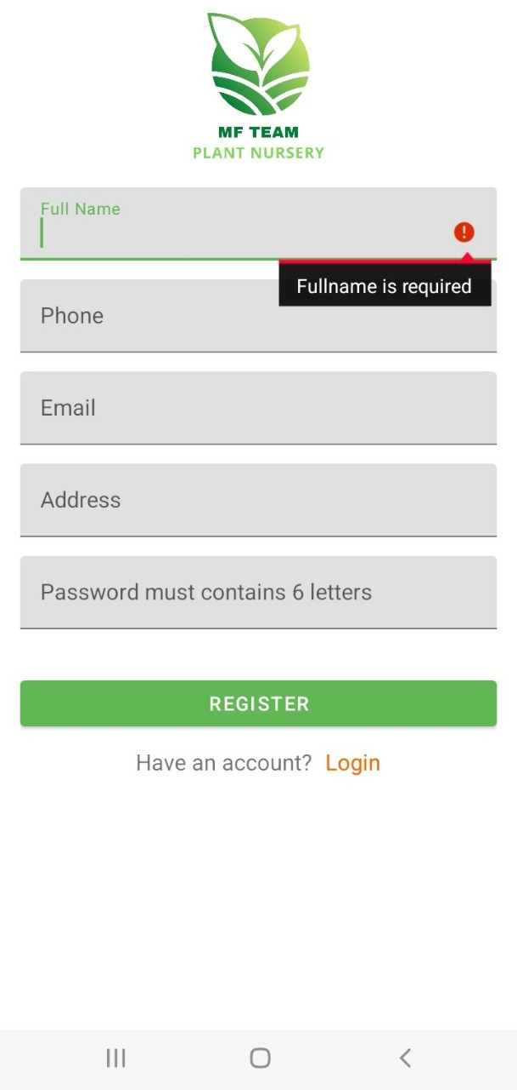
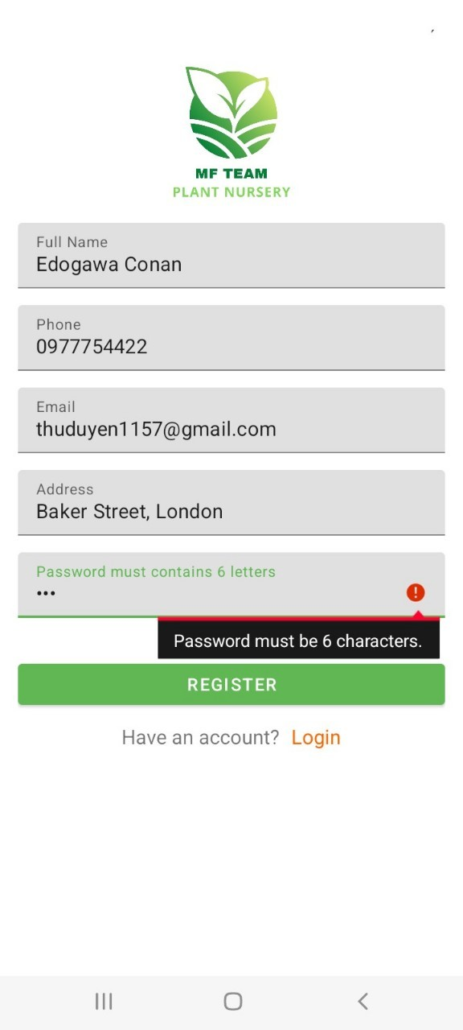
5. Demo App – 1/18
Register your account
The fields cannot be empty and the password must be at least 6 characters long

Slide 12
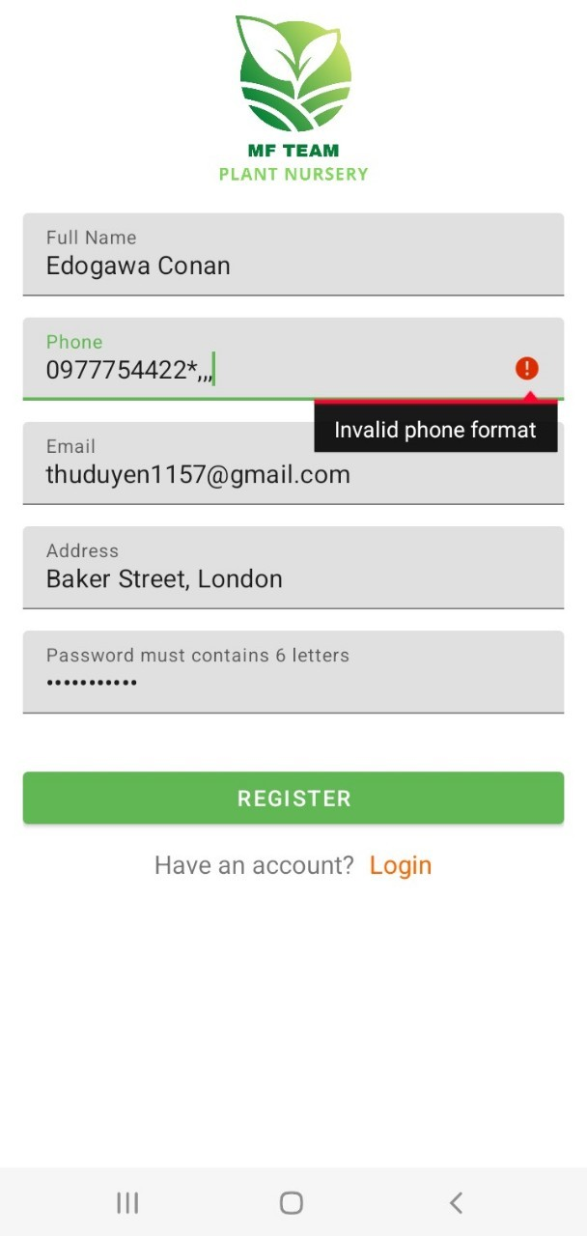
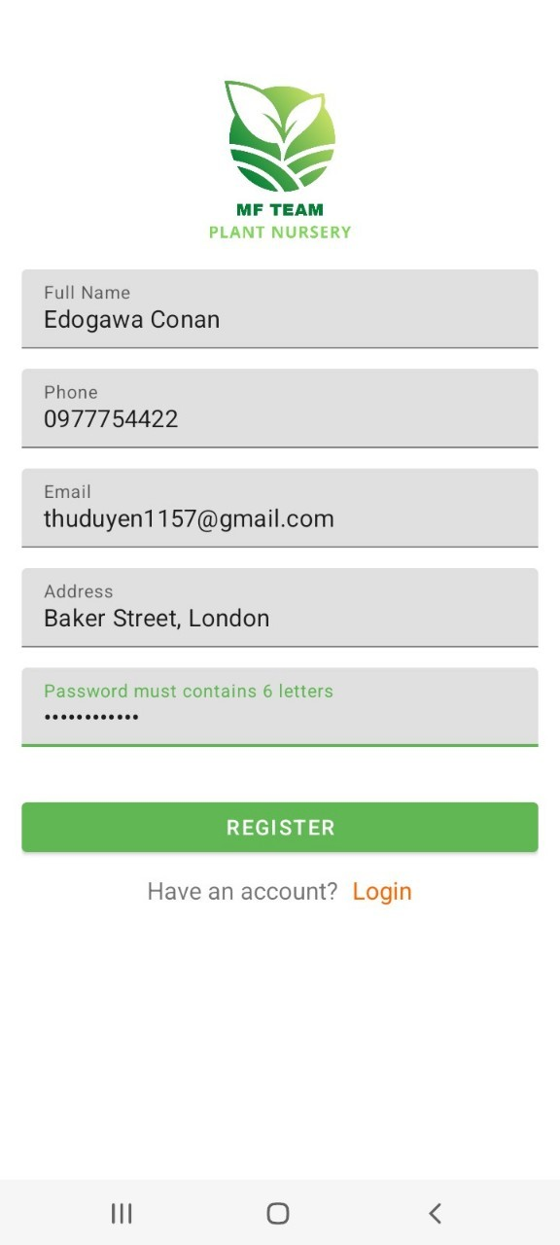
5. Demo App – 2/18
Register your account
The phone number must be a number

Slide 13
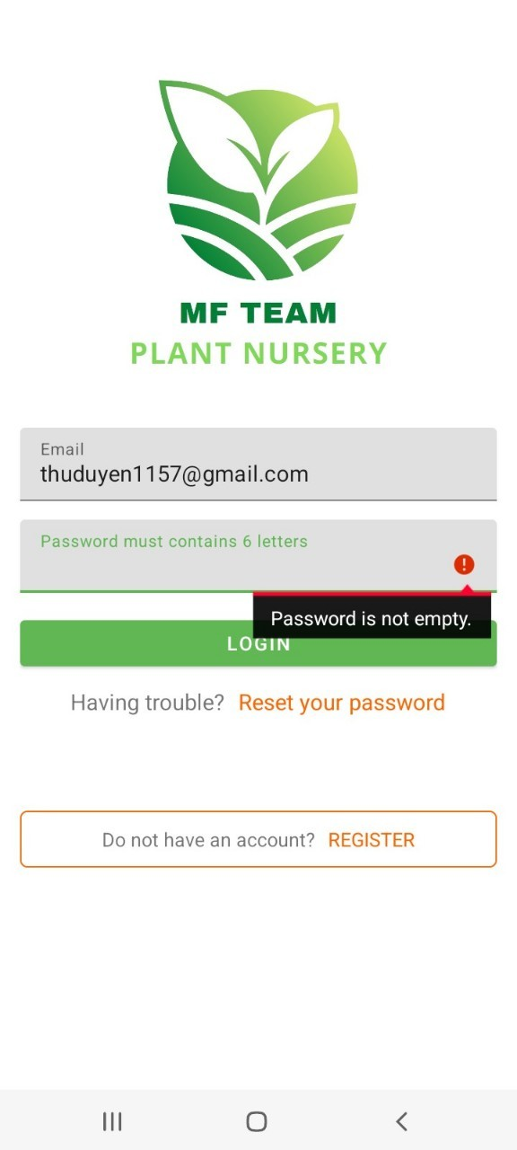
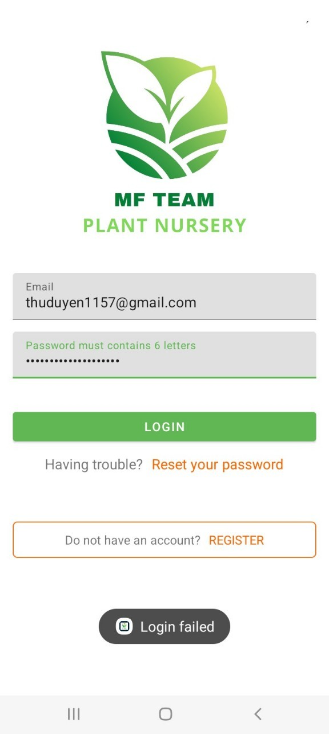
5. Demo App – 3/18
Login account
The box cannot be blank and the email/password must be valid.

Slide 14
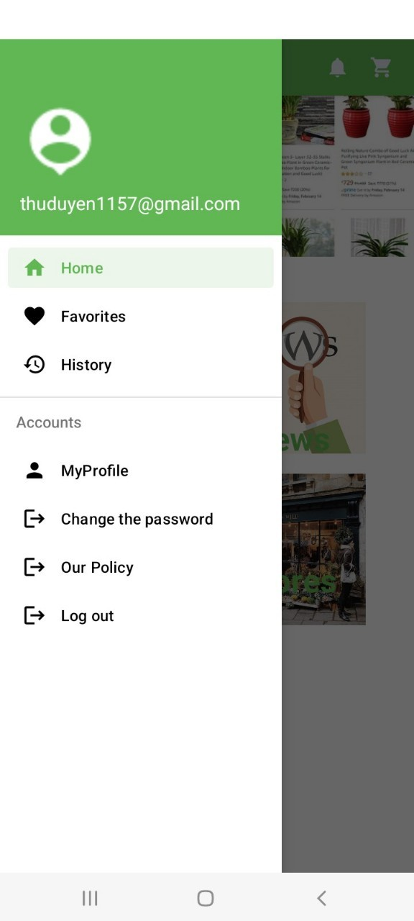
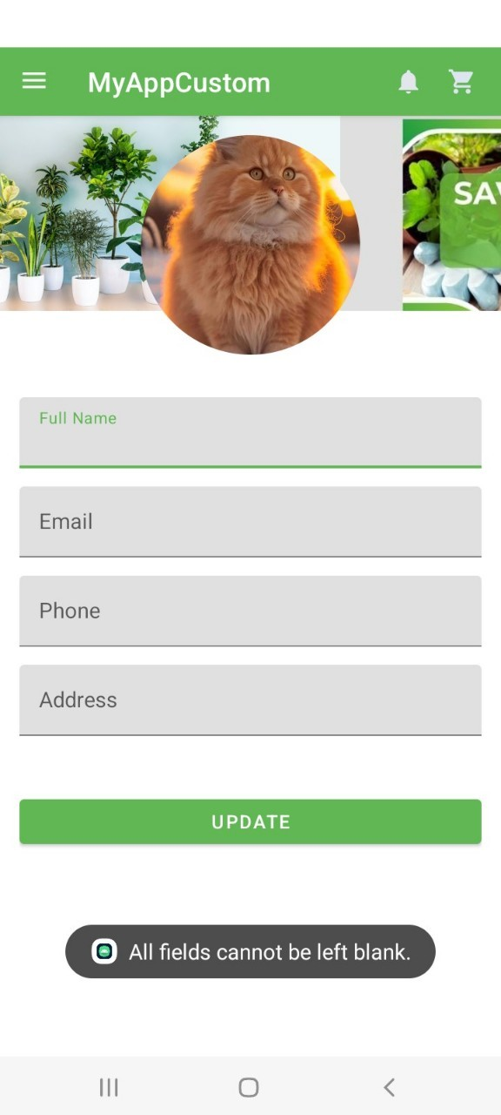
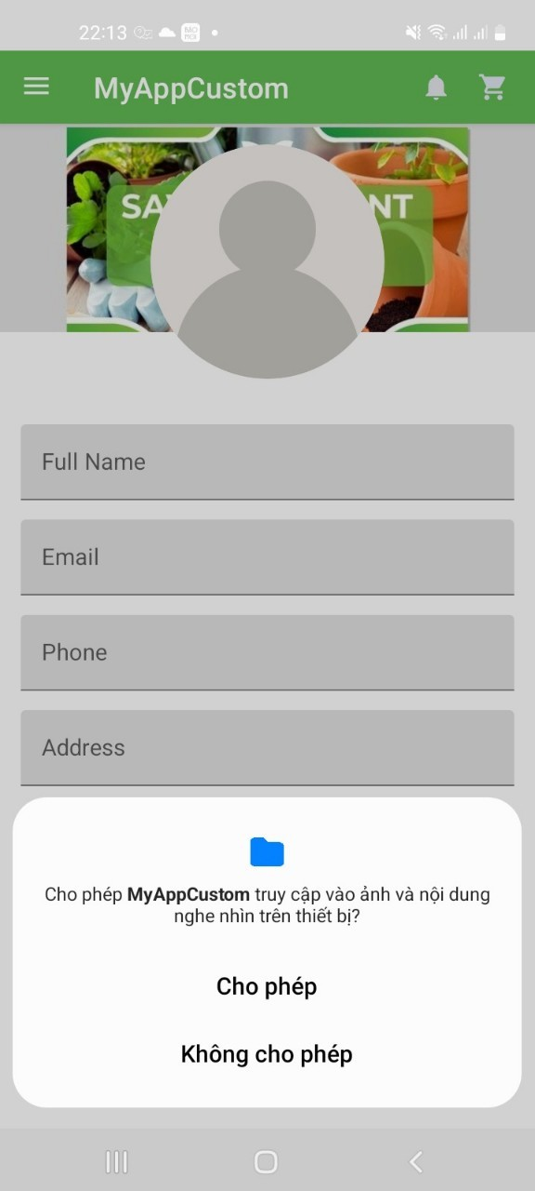
5. Demo App – 4/18
Update Information
Select the image stored on your device. The information you want to update cannot be left blank.

Slide 15
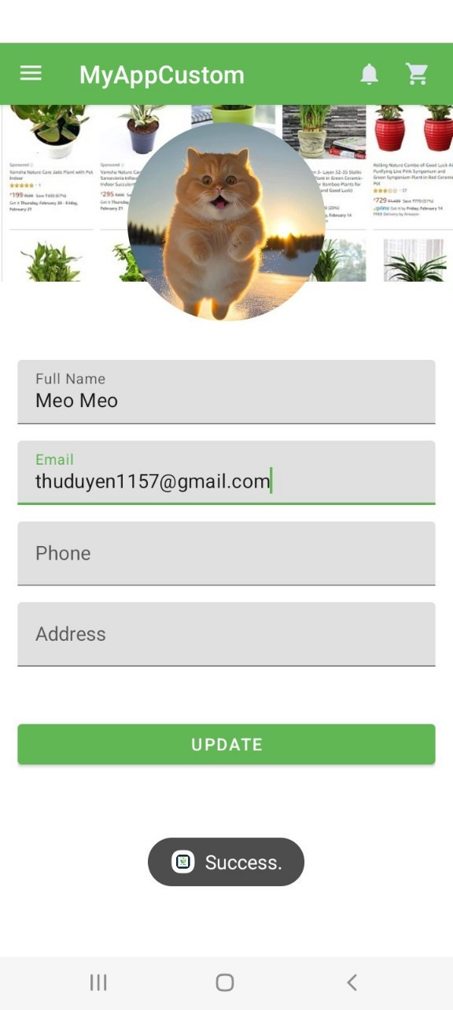
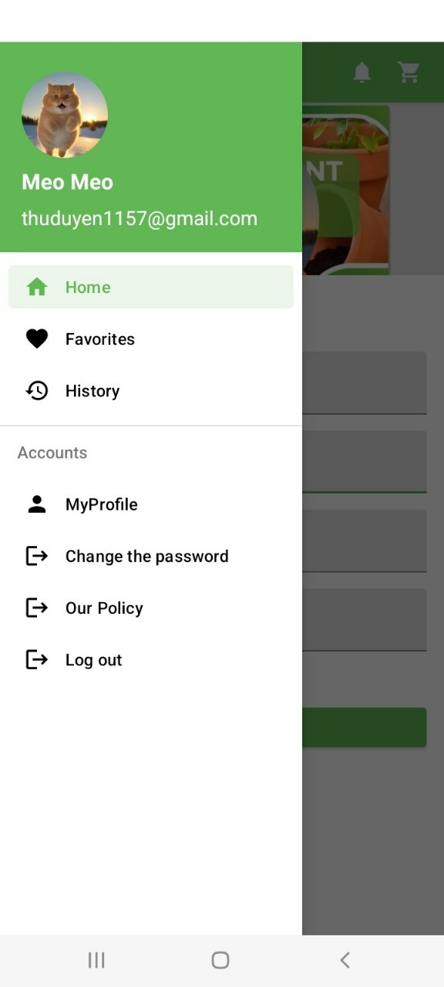
5. Demo App – 5/18
Update Information
Update successful

Slide 16
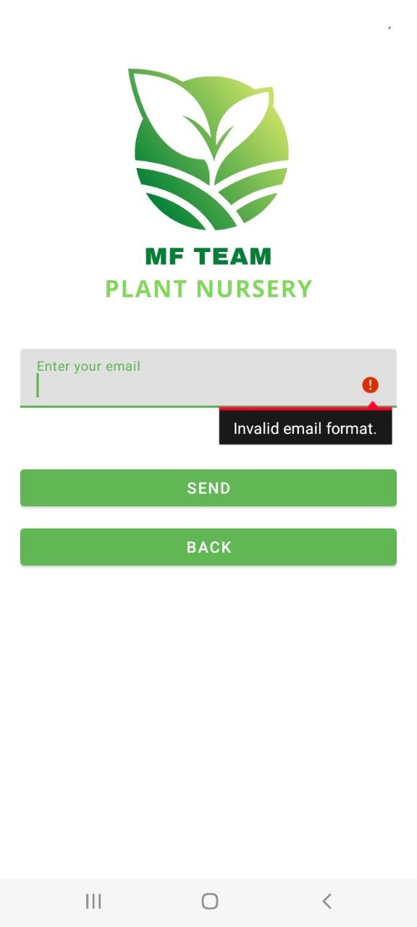
5. Demo App – 6/18
Change the password
Email is not null.

Slide 17
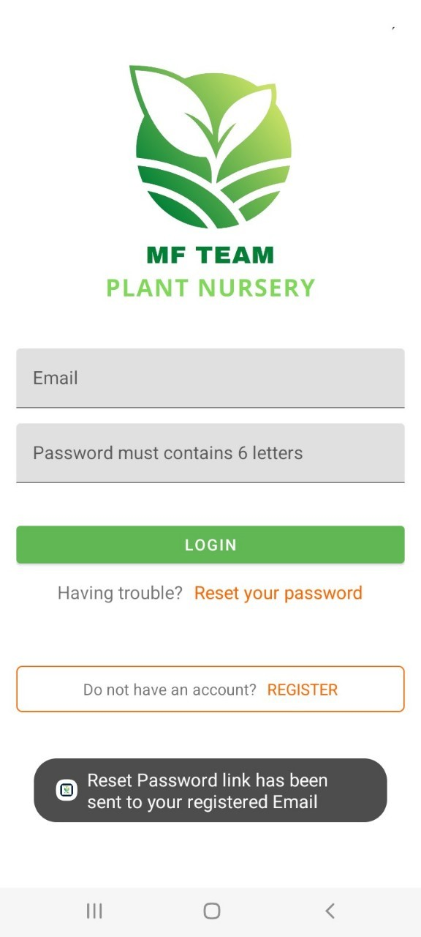
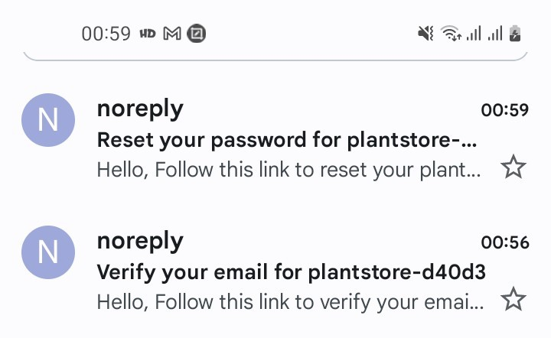
5. Demo App – 7/18
Change the password
Notify successful reset and send confirmation email.

Slide 18
5. Demo App – 8/18
Change the password
Notify successful reset and send confirmation email.

Slide 19
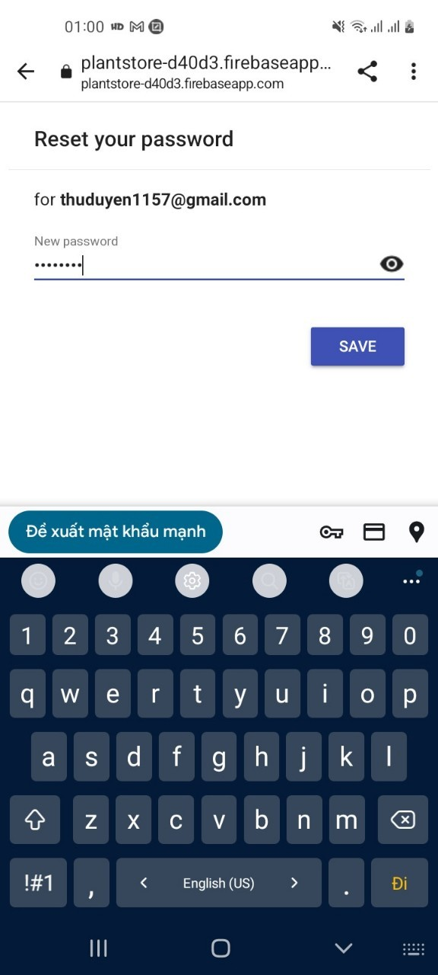
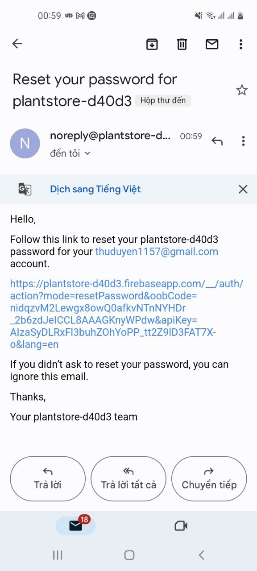
5. Demo App – 9/18
Change the password
Enter your new password

Slide 20
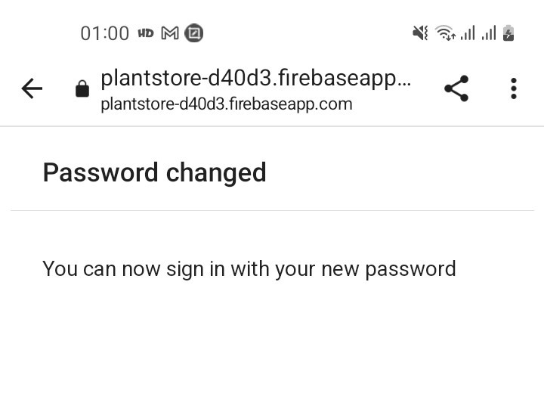
5. Demo App – 10/18
Change the password
Changed password successfully

Slide 21
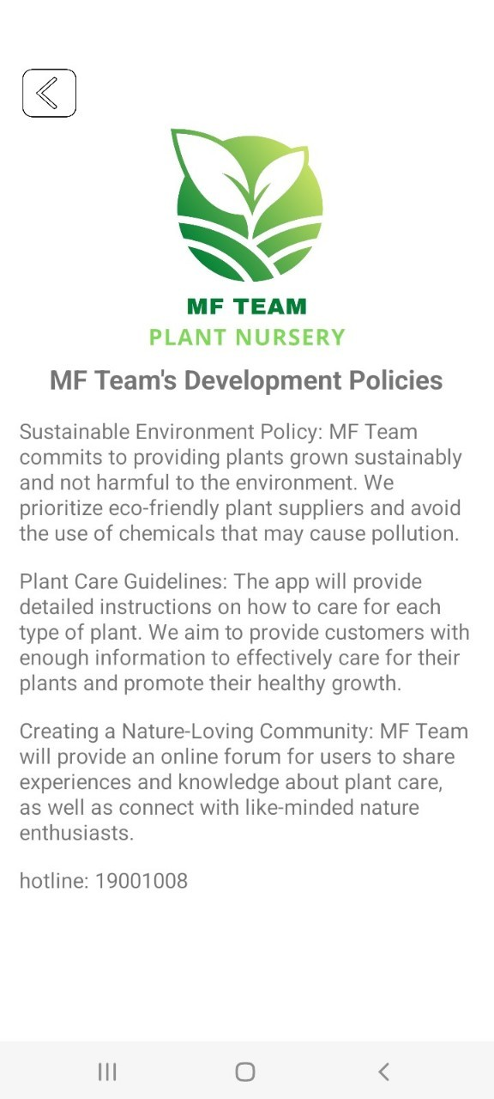
5. Demo App – 11/18
Some policies and app information

Slide 22

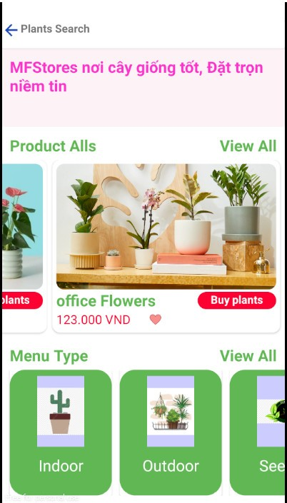
5. Demo App – 12/18
View the plant list
Shows plant type

Slide 23
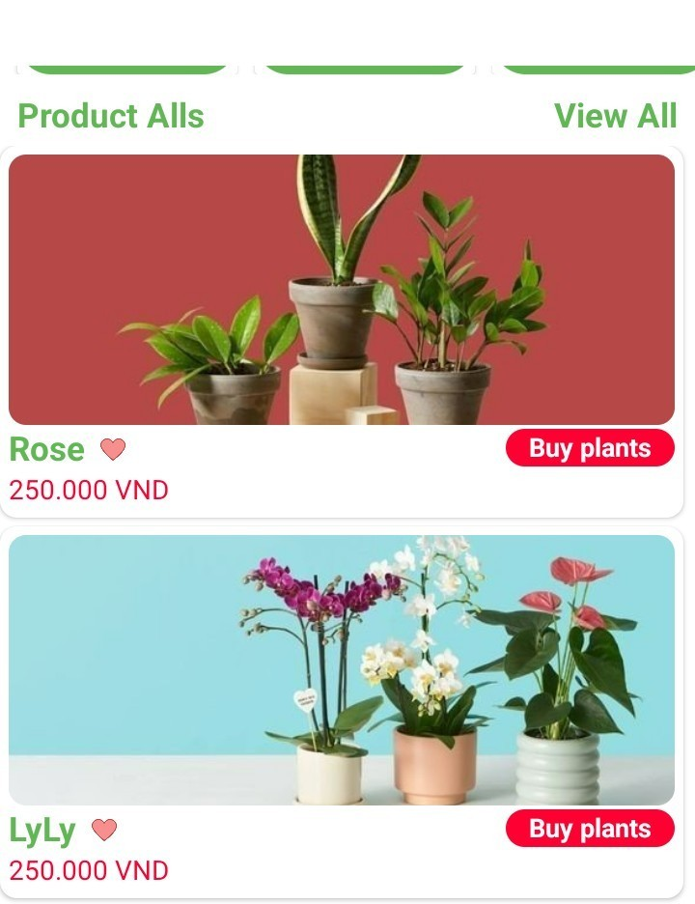
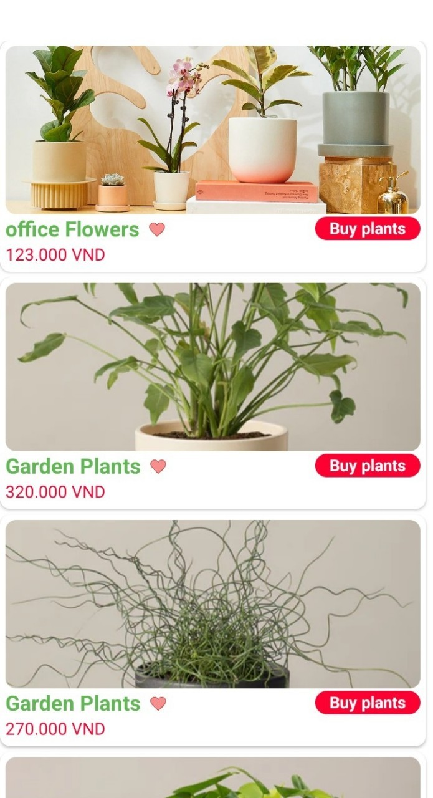
5. Demo App – 13/18
View the plant list
Show the crops

Slide 24
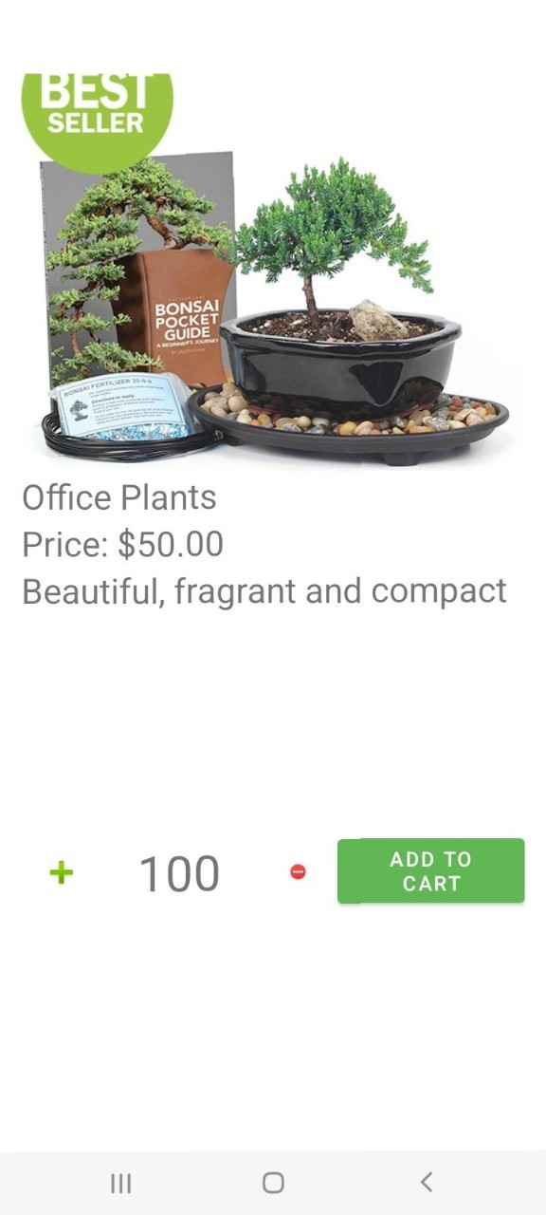
5. Demo App – 14/18
View details of the crop
Display detailed crop information (basic)

Slide 25
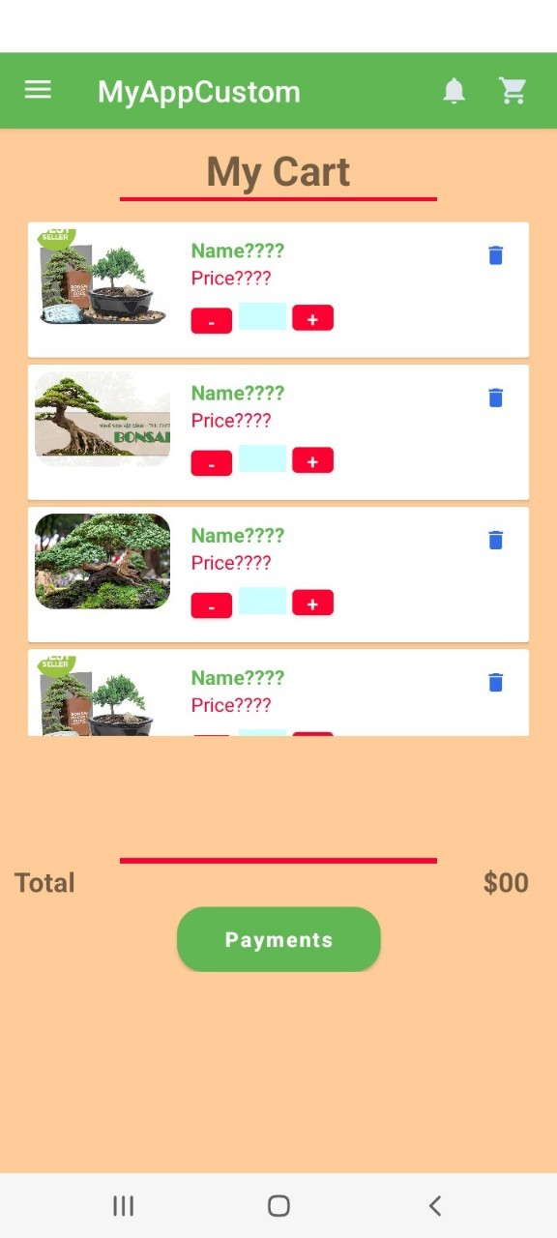
5. Demo App – 15/18
Cart Interface
Shopping cart interface (basic)

Slide 26
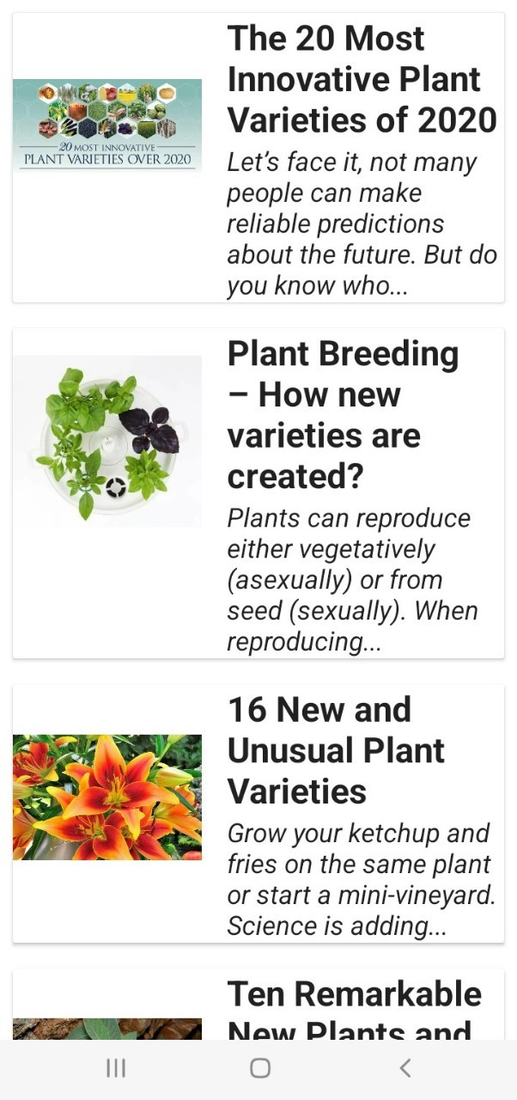
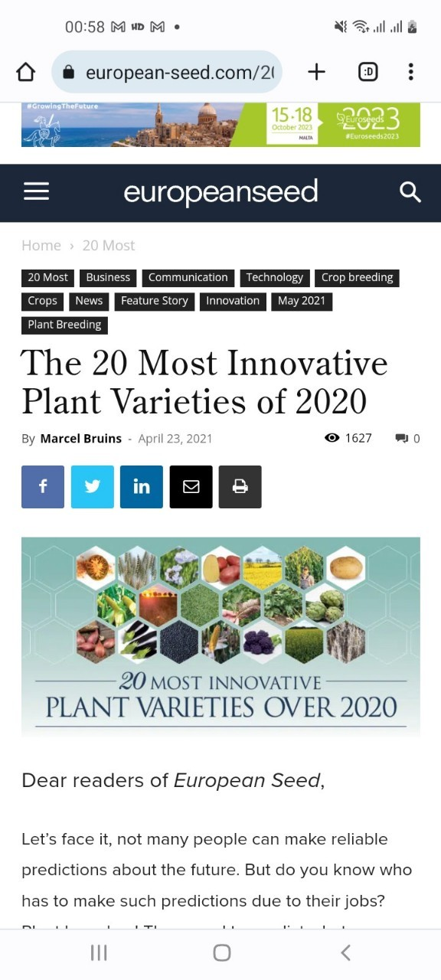
5. Demo App – 16/18
Some information about growing trees
Displays articles about plants of interest

Slide 27
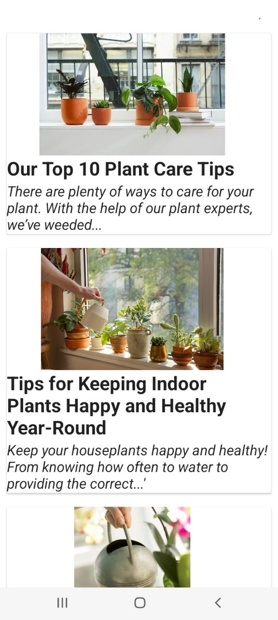
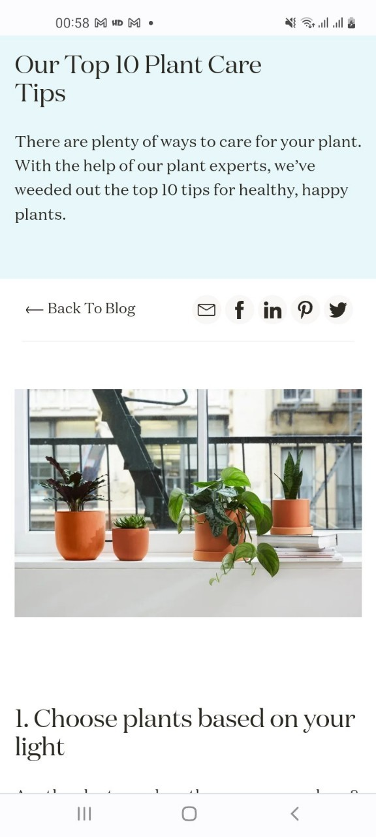
5. Demo App – 17/18
Plant care
Articles will link to informational websites.

Slide 28
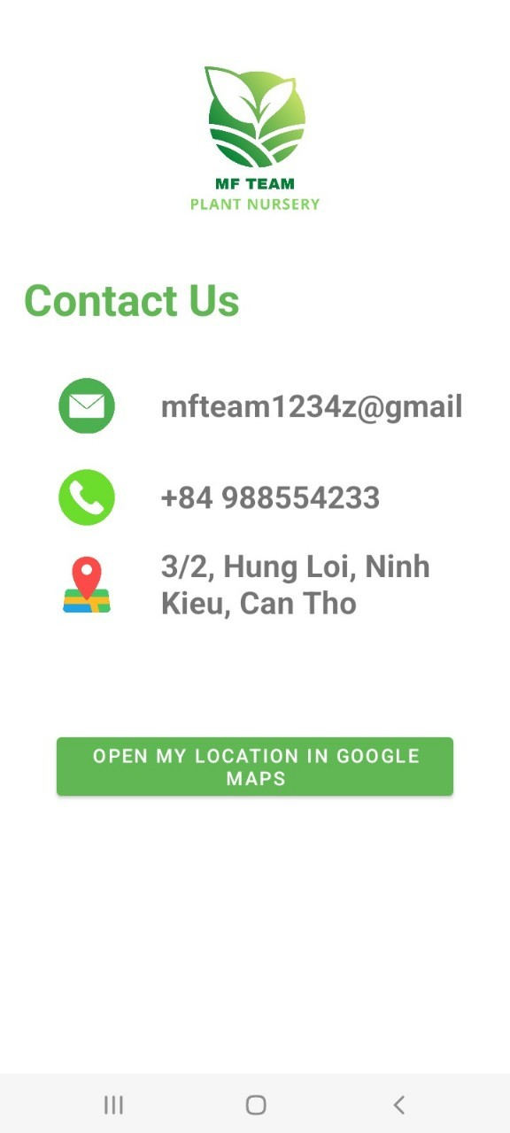
5. Demo App – 18/18
Store Information
Provide some contact information

Slide 29
6. Remaining problems
Some functions are still under development: sort, filter, cart, and order
Knowledge about Firebase is limited and needs to be learned more
Project management ability is not good, there is no clear architecture

Slide 30
THANK YOU FOR YOUR LISTENING
DO YOU HAVE ANY QUESTION?

